Slide 1
Unit 10 Live Session Assignment
Ben Goodwin

Slide 2
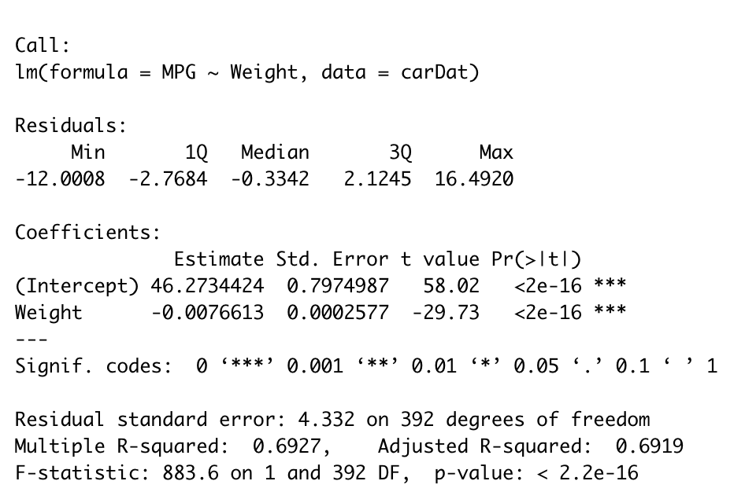
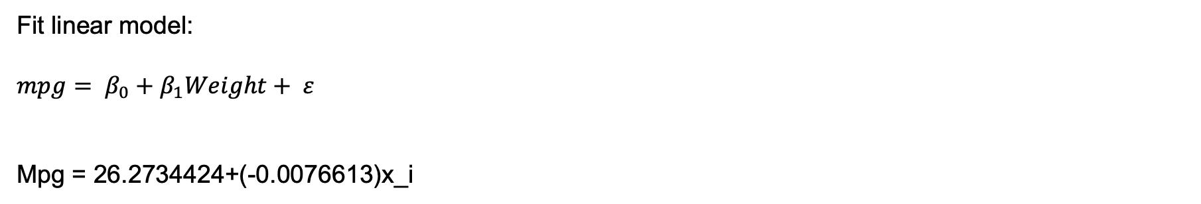
Question 1, simple linear model
Fit linear model:
$$mpg= β_{0}+β_{1}Weight+ ε$$
Mpg = 26.2734424+(-0.0076613)x_i

Slide 3
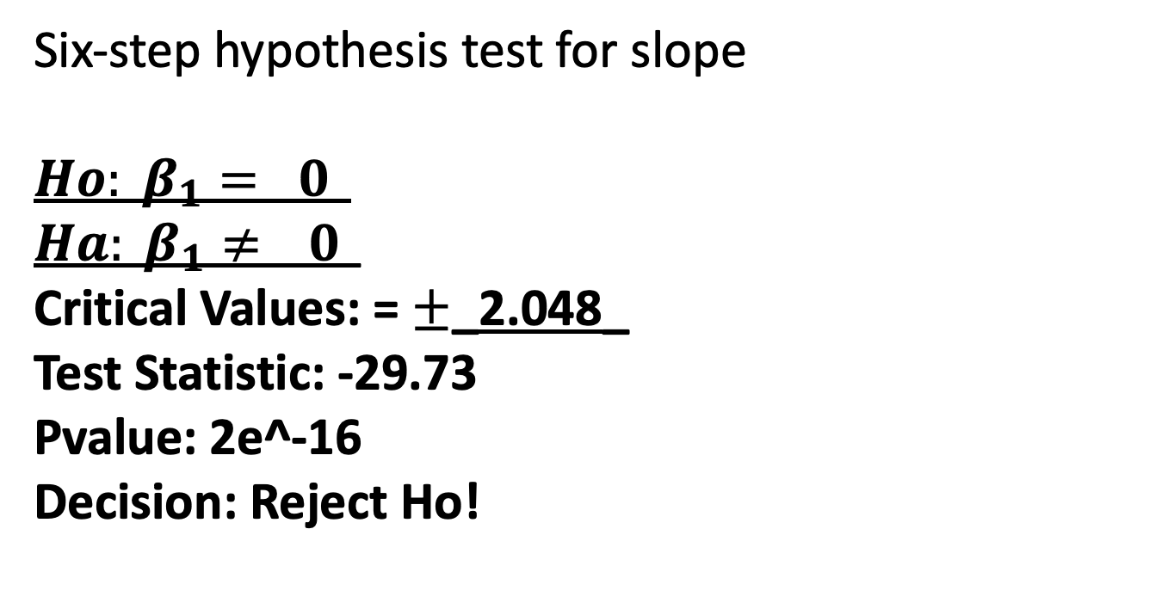
Question 1, simple linear model for
Six-step hypothesis test for slope
$$Ho: β_{1}= 0_$$
$$Ha: β_{1}≠ _0_$$
Critical Values: = $±$_2.048_
Test Statistic: -29.73
Pvalue: 2e^-16
Decision: Reject Ho!
95% CI for slope:
(-0.008168061,-0.007154609)

Slide 4
Question 1, simple linear model for
Slope interpretation: Each 1 unit increase in weight results in a 0.0076613 decrease in MPG.
95% CI for slope:
(-0.008168061,-0.007154609)

Slide 5
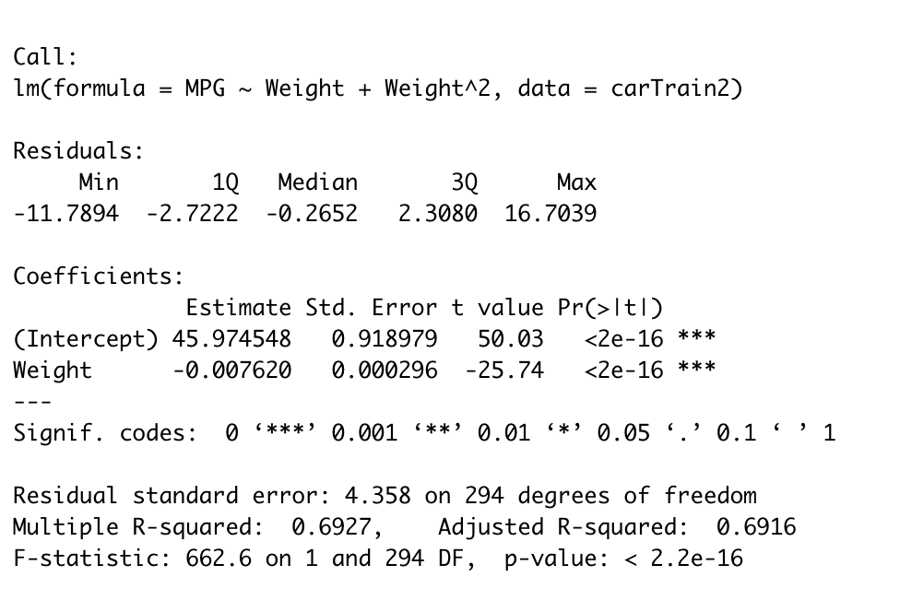
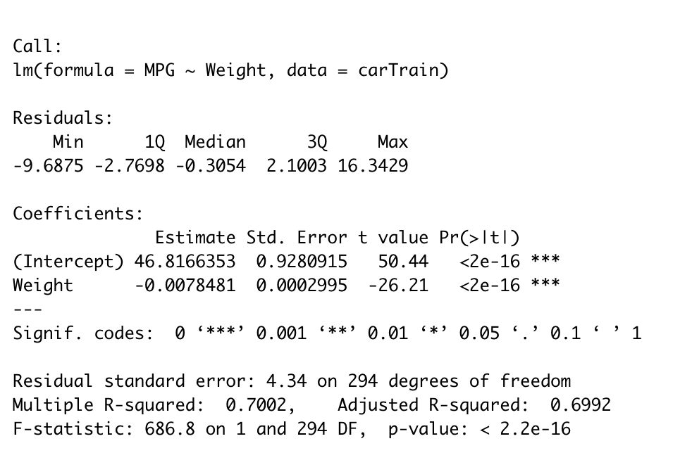
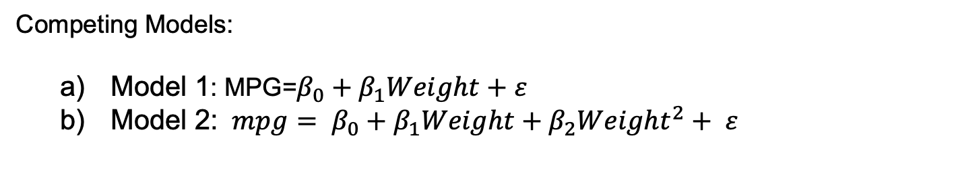
Question 2
Competing Models:
Model 1: MPG=$β_{0}+β_{1}Weight+ε$
Model 2: $mpg= β_{0}+β_{1}Weight+β_{2}{Weight}^{2}+ ε$
Model 1
Model 2

Slide 6
Question 2
Competing Models:
Model 2 is favored by cross-validation, due to its lower MPSE.
Mean 18.66 MPSE Model 1
Mean 17.33 MPSE Model 2
Describe the relationship between miles per gallon and the weight of the car:
MPG= 6.247e^1-1.882e^-2+1.756e^-6
Slope interpretation: Each 1 unit increase in weight results in a -1.882e^-2 decrease in MPG.
Intercept interpretation: We expect a car with 0 weight to get 6.247e^1 MPG
95% CI:
Intercept: (5.576147e^1,6.91749e^1)
Weight: (-2.325051e^-2,-1.438450e^2)
Weght^2: (1.066257e^6,2.445345e^6)

Slide 7
Question 2
R input (Favored model is model 2):
New Data frame for 2000lbs car
new.car <- data.frame(Weight = c(2000))
Confidence Interval for 2000lbs car prediction
predict(Model2_fit, newdata = new.car,interval = "confidence",level = 0.95)
Prediction Interval for 2000lbs car prediction
predict(Model2_fit, newdata = new.car, interval = "prediction",level = 0.95)
R output for Confidence Interval
R output for Prediction Interval
Fit: 31.85642
Lower: 31.00338
Upper: 32.70945
Fit: 31.85642
Lower: 23.56764
Upper: 40.1452

Slide 8
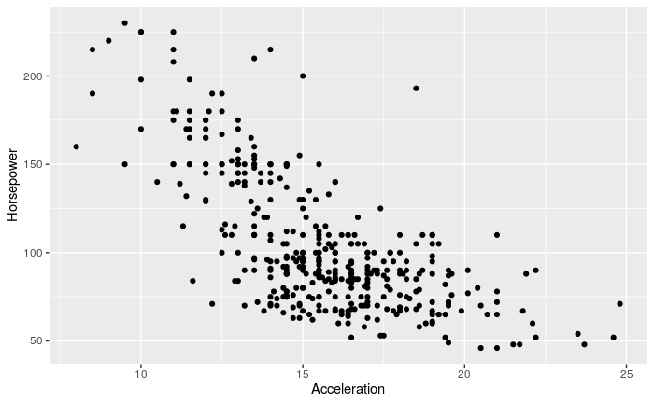
Question 3
Impute (predict and insert) the missing horsepower by fitting a regression model.
Which rows are missing values?
R input:
missingHpIdx <- which(is.na(carDat$Horsepower))missingHpIdx
R output:
351,371
Can’t use MPG, so lets use acceleration to predict HP

Slide 9
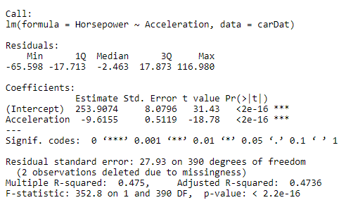
Question 3, predict missing Hp from acceleration
R input:
fit = lm(Horsepower~Acceleration, data=carDat)
summary(fit)
confint(fit)
R output:
95% CI:
Intercept: (238.02240,269.792487)
Acceleration: (-10.62195,-8.609106)

Slide 10
Question 3
Add missing HP values
R input:
Acc1<-carDat[missingHpIdx[1],]$Aceleration
Acc2<-carDat[missingHpIdx[12,]$Aceleration
missingAcc <- c(Acc1,Acc2)
missingDat <-data.frame(Acceleration=missingAcc)
Predict the horsepower
Hppred <- predict(fit,newdata=missingData)
Insert into DF
carDat[missingHpIdx[1],]$Horsepower <- predHorse[1]
carDat[missingHpIdx[2],]$Horsepower <- predHorse[2]
Predicted Horsepower:
101.9821
56.78913

Slide 11
Question 3
Mean MPG for a car with 250hp
R input:
Horse_model =lm(MPG~Horsepower+horseSqured,data=carDat)
Summary(Horse_model)
Confint(Horse_model)
Horse_preds = predict(Horse_model)
horse250 <- predict(horse_fit, newdata = data.frame(Horsepower = 250, HorseSquared = 250^2), interval = "confidence")
horse250
R output:
Fit: 16.87975
Lower: 13.13688
Upper: 20.62262

